Slide 1


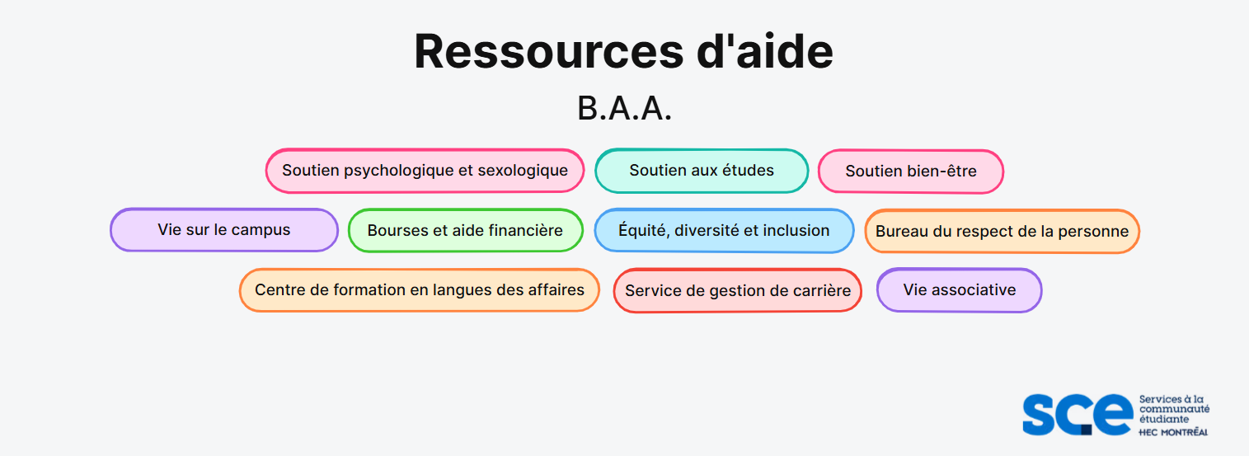

bit.ly/aideBAA

Slide 2

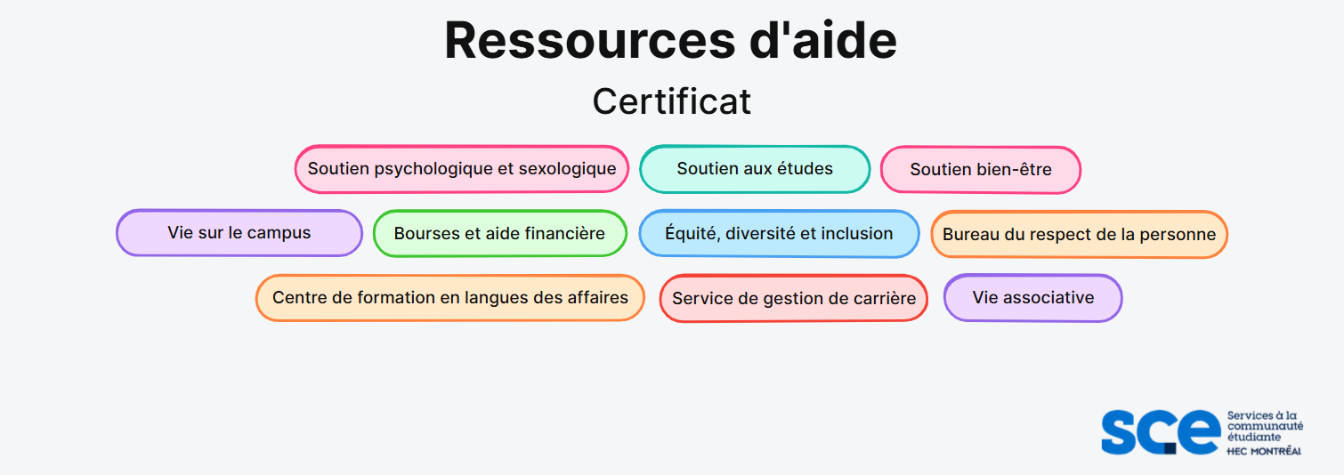
bit.ly/aideCertificat

Slide 3

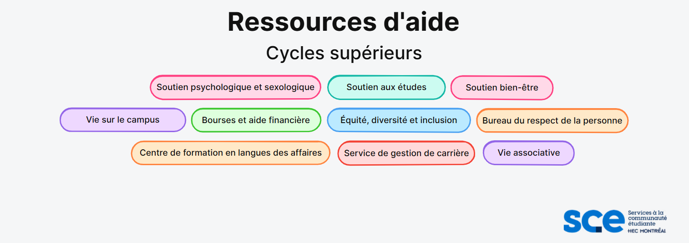
bit.ly/aideCyclesSup

